Slide 1
Boost your productivity
when working from home
Ina Pabat-Stroe – Biscotti Digital
31/03/2020

Slide 2
Business Gateway East Dunbartonshire
Offices in Kirkintilloch and Milngavie
Here to support both people planning on setting up their own business and existing companies within East Dunbartonshire
We provide practical assistance, training workshops, networking opportunities and information on the support available throughout the enterprise network and beyond
Call 0141 578 8530 to arrange to meet a Business Adviser

Slide 3
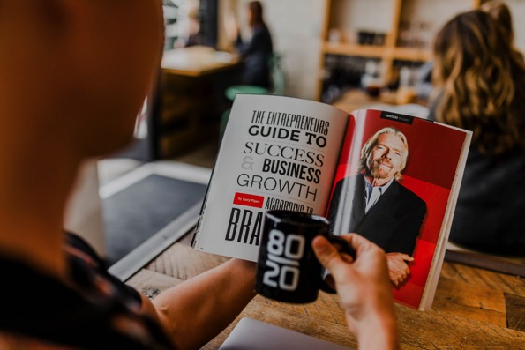
Main talking points
1. Space
2. Routine
3. Method
4. Planning
5. Inspiration and tools

Slide 4


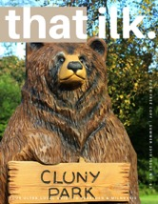
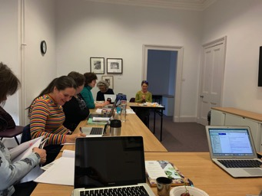
Let’s get to know each other!
Ina Pabat-Stroe
Owner Biscotti Digital – organiser of Work Jam
Publisher of that ilk. – your ultra_local guide to Bearsden and Milngavie
More than15 years in marketing
Worked for IT corporations like Xerox and Symantec
Digital marketing in agency
Small business and start up projects
Notes:
Introductions – 10 mins

Slide 5
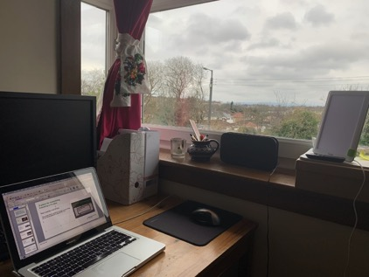
A place for everything
Useful tools I use to keep organised:
To store and share assets: Google Drive
To set meetings: 8to10 Appointments
To keep track of contacts and send marketing emails: Hubspot
Everything in it’s place
Keep a separate corner for work. (Décor ideas here: https://www.goodhousekeeping.com/home/organizing/g25576393/desk-organization-ideas/) Take some time to tastefully arrange it to your liking, so you will be tempted to spend time in it.
Organise your digital space
Organise your mental space with daily mindfulness
Why work doesn’t happen in the office:
https://www.ted.com/talks/jason_fried_why_work_doesn_t_happen_at_work
“The real problems are what I like to call the M&Ms, the Managers and the Meetings. Those are the real problems in the modern office today. And this is why things don't get done at work, it's because of the M&Ms.

Slide 6
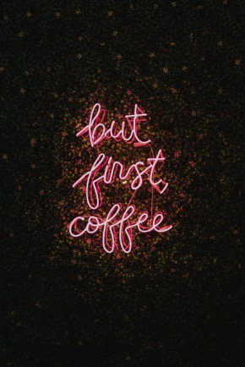
Freedom of choosing a routine
Ask yourself:
Are you a lark or an owl?
that works for you
Follow your natural circadian rhythm
“On average, after the workday begins, employees take a few hours to reach their peak levels of alertness and energy — and that peak does not last long. Not long after lunch, those levels begin to decline, hitting a low at around 3pm. We often blame this on lunch, but in reality this is just a natural part of the circadian process. After the 3pm dip, alertness tends to increase again until hitting a second peak at approximately 6pm. Following this, alertness tends to then decline for the rest of the evening and throughout the early morning hours until hitting the the very lowest point at approximately 3:30am. After hitting that all-time low, alertness tends to increase for the rest of the morning until hitting the first peak shortly after noon the next day. A very large body of research highlights this pattern, although of course there is individual variability around that pattern.”
“Naps can be a good way to regulate energy as well, providing some short-term recovery that can increase alertness. A large body of evidence links naps to increases in task performance.
Source
https://hbr.org/2015/01/the-ideal-work-schedule-as-determined-by-circadian-rhythms
Notes:
1911 invention
1930 Wonder bread launches it into a national phenomena

Slide 7
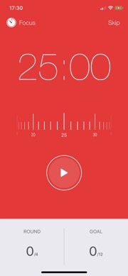
Achieve more in the time you have
Useful tools
https://tomato-timer.com/
Focus Keeper – Time Management app
With the Pomodoro technique
The Pomodoro Technique is a time management method developed by Francesco Cirillo^{[1]} in the late 1980s.
The technique uses a timer to break down work into intervals, traditionally 25 minutes in length, separated by short breaks. Each interval is known as a pomodoro, from the Italian word for 'tomato', after the tomato-shaped kitchen timer that Cirillo used as a university student. (Wikipedia)
Break your workday into 25-minute chunks separated by five-minute breaks. After about four pomodoros, take a longer break of about 15 to 20 minutes.

Slide 8
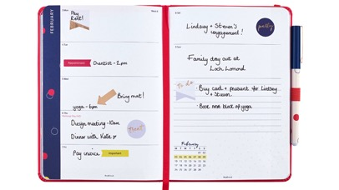
The importance of being organised
Apps:
Evernote
Google Task
Todoist
Trello
Why planning is your friend
Planning reduces your stress levels. Gain peace of mind of knowing that you have a vision for the path ahead and that you control the outcome in some part
Planning helps you be prepared for obstacles because part of the planning process is anticipating potential hurdles or the simple act of anticipating what’s to come.
Planning helps you evaluate your progress as you work. Planning your daily and weekly activities will clearly illustrate whether or not you are on track with your goals.
https://busyb.co.uk/which-diary-are-you

Slide 9
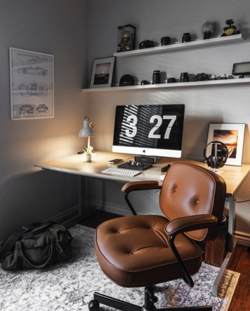
What is your game plan?
Easy to implement tips
Plan the day before
Start by listing everything you want to achieve the next day, then group tasks into allocated chunks (ex. all tasks I need to do at my desk, tasks I can tackle on the go). Ignore emails and messages until your first and foremost goal is achieved
Know your desired outcome and motives (ex. My daily goal is to push my projects further so I prioritise that: answer emails, chase people, do the most important work first)
Bundle tasks: something less pleasant followed by something you find rewarding (that doesn’t involve cookies in my case!)

Slide 10
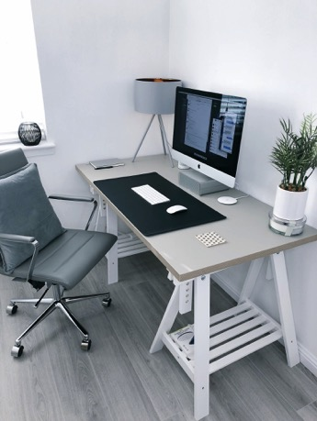
Remember to plan for wellness
Have time for yourself every day
“Schedule everything
“As tempting as it is to leave personal needs off your calendar, the reality is that, when you get busy, those are the first tasks to get lost in the shuffle. Prioritizing your overall physical, mental and emotional health forms the cornerstone of lasting success. Schedule in everything, from daily meditation to exercise.”
https://www.tonyrobbins.com/importance-time-management/how-to-plan-your-day/

Slide 11
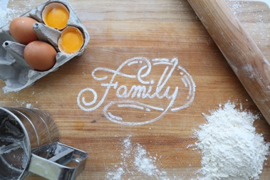
Daily planner
An example based on my household
8.00 Wake up and groom
Breakfast and tidy up
8.50 Stretches
Word of the day
Maths
Break and snack
Spelling and languages
12.00 PE with Joe Wicks
Lunch and tidy up
Pupil’s choice activity: coding, arts, science, etc
Break
Pupil’s choice activity until 3pm
After lunch: grown up work
Dog walk
Dinner and one last tidy up
Shower
Reading time
8.30pm Bed time
Once the house is quiet I plan for the following day’s activities, food, etc
In the afternoon the only rule is: “don’t bother me, I won’t bother you”
I try my best to rope in everyone for tidy up

Slide 12
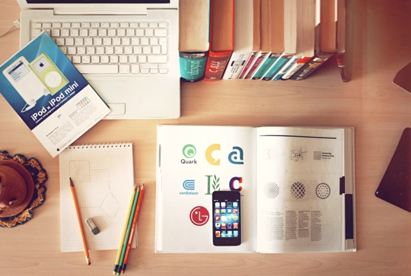
Further useful tools
for home working
Toggl
If you want a free time tracker that allows you to label how you've spent every minute of every day, Toggl is for you. It's a great tool for personal productivity measuring.
10to8 Appointment Scheduling Software
It is important that remote teams constantly stay in touch and have regular catch-ups. 10to8 Appointment Scheduling Software will make it easy to arrange recurring meetings, like daily standups and weekly team meetings, as well as ad-hoc phone calls at times that are convenient for all participants.
10to8 can handle staff members in multiple time zones, so if you have a team spread worldwide, that’s not a problem at all. Thanks to the native Zoom integration, it’s dead easy to hop on a video call straight from your diary.
Krisp
Krisp is a simple yet incredibly powerful noise-canceling app. So if you ever take phone calls from non-soundproofed rooms, you’ll definitely need it.
Be it a video call with your teammates, an important conference call with partners or a short voicemail to a client, Krisp will come in handy. It supports microphones, headphones, and speakers, and it is perfect for remote teams, online teachers, podcasters and even call centers.
Trello
Trello is a collaboration tool that organizes your projects into boards. In one glance, Trello tells you what's being worked on, who's working on what, and where something is in a process. Imagine a white board, filled with lists of sticky notes, with each note as a task for you and your team.
Focusmate virtual coworking provides accountability exactly when and how you need it to get things done—live, "in person" from another human being.
Notes:
Practical exercise – 10 mins

Slide 13
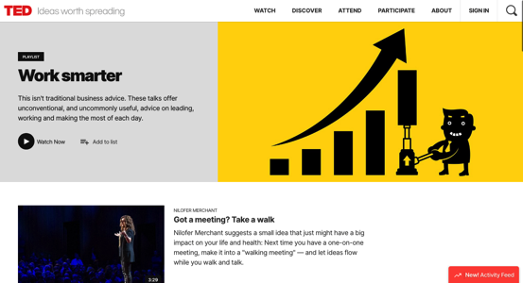
Ideas to inspire you
Work smarter, think out of the box
"Blame is not for failure. It is for failing to help or ask for help.”
LEGO Group's former CEO
https://www.ted.com/playlists/60/work_smarter
We believe we should work hard in order to be happy, but could we be thinking about things backwards? In this fast-moving and very funny talk, psychologist Shawn Achor argues that, actually, happiness inspires us to be more productive.
“Normal is merely average”
“The lens through which your brain views the world shapes your reality.”
“90% of your long term happiness can be predicted by the way your brain processes the world.”
https://www.ted.com/talks/shawn_achor_the_happy_secret_to_better_work

Slide 14
Thank you!
ina@biscottidigital.co.uk

