Slide 1
Create strategic online content
to attract, engage and covert
Ina Pabat-Stroe – Biscotti Digital
6 April 2020

Slide 2
Business Gateway East Dunbartonshire
Offices in Kirkintilloch and Milngavie
Here to support both people planning on setting up their own business and existing companies within East Dunbartonshire
We provide practical assistance, training workshops, networking opportunities and information on the support available throughout the enterprise network and beyond
Call 0141 578 8530 to arrange to meet a Business Adviser

Slide 3
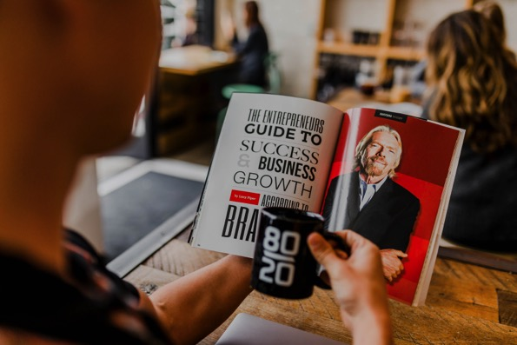
Main talking points
1. Research your topics
2. Plan your content
3. Stunning visuals
4. Planning
5. Inspiration and tools

Slide 4
Let’s get to know each other!
Ina Pabat-Stroe
Owner Biscotti Digital – organiser of Work Jam
Publisher of that ilk. – your ultra_local guide to Bearsden and Milngavie
More than15 years in marketing
Worked for IT corporations like Xerox and Symantec
Digital marketing in agency
Small business and start up projects
Notes:
Introductions – 10 mins

Slide 5
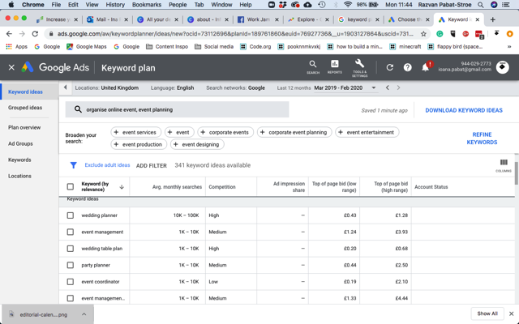
Research topics
Useful tools
Emerging topics: Google Trends
Your market behaviour: Google Keyword planner and Google search
Your industry news: The Old Reader

Slide 6
Plan your content
Popular topics
Create a relationship culture
How to guides
Beginner guides
Ultimate guides
Frequently asked questions
Interviews
Personal stories
Charity and activism
Breaking news
Myth debunking
Troubleshooting guides
Contests, gifs and memes, funny stories
Advice and tips
Historic lessons
Upcoming events
Support
Best-ofs
Lists
Secrets of the trade
Customer success stories
Notes:
1911 invention
1930 Wonder bread launches it into a national phenomena

Slide 7
Match topics with customer journey
Offer the right content at the right stage
Awareness people looking for answers, resources, education, research data, opinions, and insight
Consideration: people are doing heavy research on whether or not your product or service is a good fit for them
Decision: people are figuring out exactly what it would take to become a customer
Tips, tutorials, resource roundup, checklist, how to video
Testimonials, case studies, free samples, demo video, product focus webinar
Free consultation, free trial, other incentives and offers, limited time discounts, bundles, etc
Match type of content with your market and their needs:
truck drivers need podcasts, makeup artists need videos
Notes:
top-level educational content to help direct them to a solution, like blog posts, social content, and ebooks
where you want to show why your solutions in particular are the best fit. you’re nurturing a lead, building a relationship, and establishing trust between the audience and your brand.
final nudge and that compelling call-to-action to get them to make a purchase decision. The right offer and content at this stage can have a dramatic impact on lifting your conversions.

Slide 8
Use an editorial planner
To keep you on track
Date to go live
Type of content
Topic/Headline
Target audience/Customer journey phase
Where it will be shared (distribution channel)
Use Trello, a spreadsheet or an app like Airtable to keep on track
Source: https://contentmarketinginstitute.com/2017/04/editorial-calendar-tools-templates/

Slide 9
Stunning visuals
Tools to improve your artwork
Authentic content: create your own images, artwork and videos
Stock images and videos: Unsplash.com, Pixabay.com. Pexels.com, Pikwizard and Gratisography. For illustration, try Mixkit.co - some of the artwork on offer is royalty free. Visual patterns are available here: thepatternlibrary.com
Edit images with: Quikshot, VSCO Edit video with: Quik, Adobe Premier Rush, Cutshot, Splice Edit artwork: Canva, Adobe Spark
Royalty free icons: thenounproject.com
Fonts: Google fonts
Colour palette inspiration: colorlovers.com, colorhexa.com
Everything and anything graphic design: envato.com, creativemarket.com

Slide 10
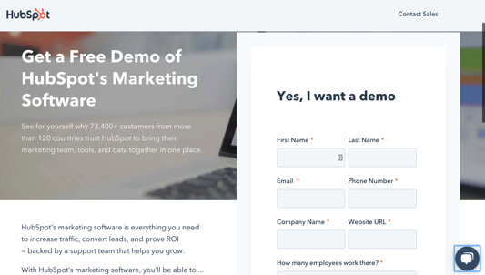
Free content, gated content
Turn valuable content into lead magnets
Ask visitors for email to download useful content
A lead magnet is an irresistible offer that users can receive in exchange for specific contact information.
Ideally, you want the lead magnet to be something that resonates with your target audience so you’re attracting qualified leads into your system:
E-books, whitepapers, guides in .pdf shape

Slide 11
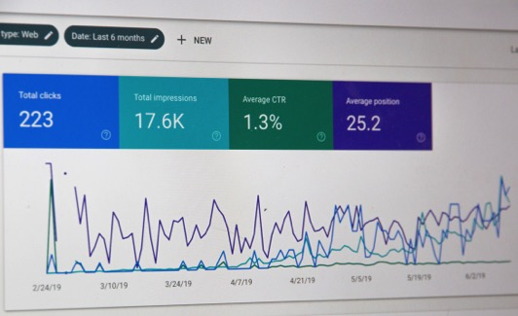
SEO basics
Easy to apply rules
Social media marketing will give a blog post some traction, but SEO will give it longevity and unlimited potential.
Three rules
1. Find the best target keywords by performing research
2. Use on-page SEO
3. Build backlinks

Slide 12
On-page SEO
Create on topic, relevant, well written copy
Use Grammarly to check on-page spelling
1. Your target keywords: H1 headline, URL and reasonably sprinkled in the text, images alt tags
2. Add internal and external links to relevant content
3. Break text with relevant subheadings
4. Stay on topic with the content and write a good quality paragraph at the beginning to summarize it.

Slide 13
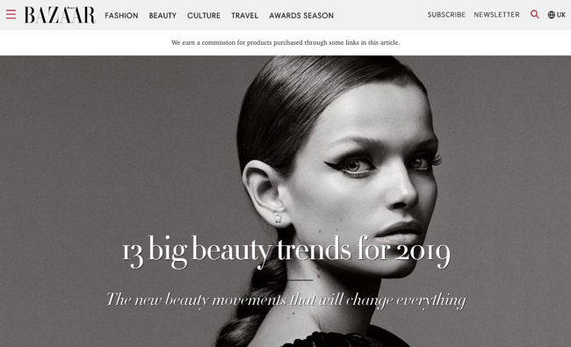
Use backlinks to boost SEO
Offer your useful content to others
Other relevant sources linking back to your content
Backlink must come from trusted, authoritative websites that are topically related to your website
Make sure you create valuable content

Slide 14
Anatomy of a good quality piece of content
Calls to action - Use them everywhere!
Subscribe!
Further browse relevant content!
Get in touch!
Ask for a quote!
Register here to download
Order today
Click here!
Share with friends!
Catchy headline that contains target keywords
Brake copy into paragraphs by sub-headlines, images and calls to action
Offer content in various forms: video at the top, copy after, infographics, supporting images and banners, downloadable pdfs, etc
Further useful content suggestions
Encourage social shares

Slide 15
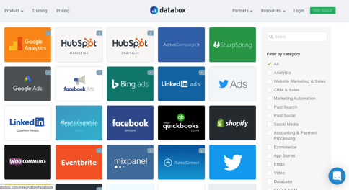
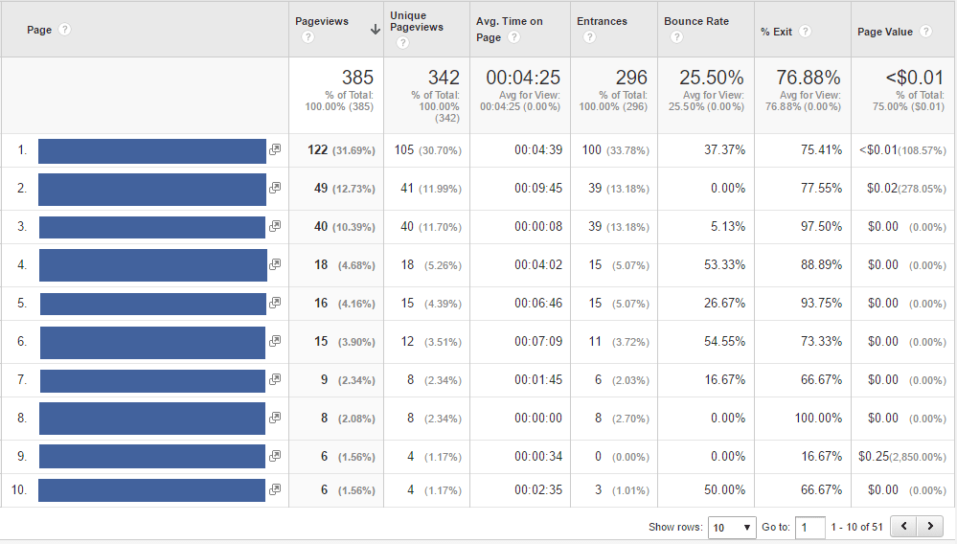
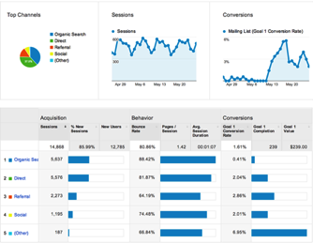
Monitor your progress
Monthly analyze your traffic volume
Use a free dashboard like Databox
Google Analytics:
To see most read pages on your website open Google Analytics and navigate to Behavior -> Site Content -> All Pages.
To see website traffic sources, open Google Analytics and navigate to Acquisition ->All Traffic
Social channels insights
Notes:
Practical exercise – 10 mins

Slide 16
Content best practice
A few ethical considerations
Keep your content original
Research to the best of your ability and abstain from spreading misinformation
Use trustworthy sources, accredit work accordingly
Ask permission where necessary

Slide 17
Thank you!
ina@biscottidigital.co.uk

