Slide 1
Increase your digital presence
and establish an online sales funnel
Ina Pabat-Stroe – Biscotti Digital
6 April 2020

Slide 2
Business Gateway East Dunbartonshire
Offices in Kirkintilloch and Milngavie
Here to support both people planning on setting up their own business and existing companies within East Dunbartonshire
We provide practical assistance, training workshops, networking opportunities and information on the support available throughout the enterprise network and beyond
Call 0141 578 8530 to arrange to meet a Business Adviser

Slide 3
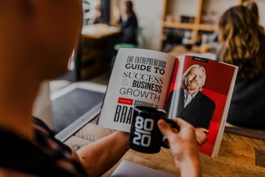
Main talking points
1. Establish an online presence
2. Website
3. Signposts
4. Email
5. Social
6. Relationships
7. Paid campaigns
8. Monitoring results

Slide 4
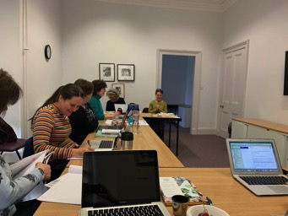
Let’s get to know each other!
Ina Pabat-Stroe
Owner Biscotti Digital – organiser of Work Jam
Publisher of that ilk. – your ultra_local guide to Bearsden and Milngavie
More than15 years in marketing
Worked for IT corporations like Xerox and Symantec
Digital marketing in agency
Small business and start up projects
Notes:
Introductions – 10 mins

Slide 5
Establish an online presence
How easy is it to be found online
Build your reputation and establish trust
Increase brand awareness
Provide visibility for your products and services
Key to establish a relevant online presence: create value

Slide 6
Improve Your Website
Why?
Good quality tried and tested platforms:
Wordpress
SquareSpace
Wix
Shopify – for online retail
97% of consumers use the internet to find a business – Source https://blog.hubspot.com/marketing/online-presence
A website belongs to you 100%
The content stays available and searchable for as long as you want it to be
Not victim of fashion trends and dwindling audiences
Benefit from traffic brought by search engines organically
Build for mobile first!
Further read on building website trust: https://www.crazyegg.com/blog/build-trust/
Notes:
Think when you search something on Google vs when you stumble upon something on social

Slide 7
Website
A healthy structure
Create a relationship culture
Integrate links to all your social channels and further relevant presence
A strong Home page
A dedicated About page to detail your business story and increase trust
Product and services pages built as resource pages linking to further useful content: product description, previous successful sales, testimonials, detailed tutorials and FAQ’s around that product
All pages must have a CTA!!
Watch loading times as they can really impact your user experience
Notes:
1911 invention
1930 Wonder bread launches it into a national phenomena

Slide 8
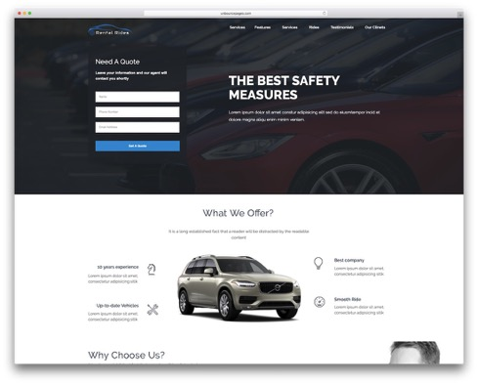
Landing pages and resource pages
Further ways to structure your content
The main purpose of your website is to capture correct audiences and convert them into leads and further, into clients.
Resource pages are pages that bring together all content related to one topic creating clusters of competency
Landing pages are pages that focus on one specific topic, industry, product with the aim to encourage users to register in order to download a free resource or join an event
Notes:
Go to hubspot pillar pages

Slide 9
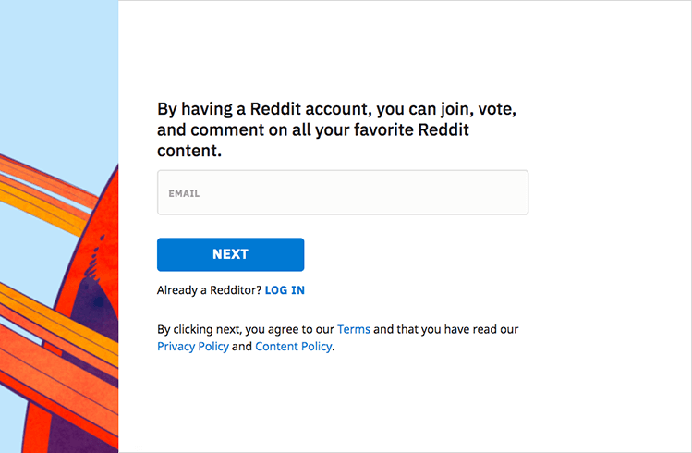
Calls to action
And sign up forms
Signup forms are essential: only ask for essential information, make sure you have a clear privacy policy and explain how you would use and store the data
Each page on your website should have a Call to action: to further browse, to get in touch, to signup, to register, to download, etc

Slide 10
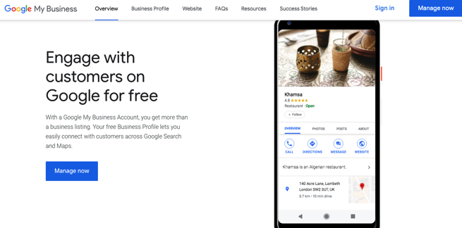
Online directories
Signpost your website
Bing Places
Google My Business
Yelp
Yellow Pages
Ask yourself: where do my customers go to look for my kind of services?

Slide 11
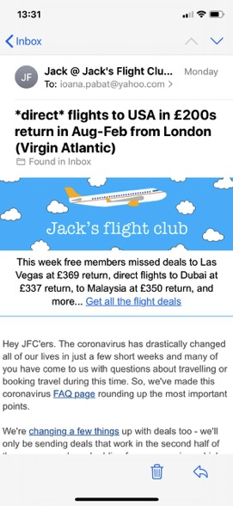
Email outreach
Nurture leads with killer email content
Website visitors who have offered their email contacts are incredibly valuable
Continue communicating with them on a weekly basis – offering engaging, rewarding content
Use email automation with Mailchimp or Hubspot

Slide 12
Social channels
Make use of all tools available
Most people research businesses and make a judgement based on whether they have an active social presence.
Refresh your social channels, make use of all opportunities offered: fill in accurate consistent descriptions and contact information, images, banners, etc.
If you produce video content, set up a Youtube channel and integrate it with your website for SEO good practice
Notes:
What are the platforms where your customers are? Focus on those.
Are your customers early adopters?

Slide 13
Partners, influencers and guest posting
Reach as far as you can
Use your existing relationships to guest post content on their blogs and socials – build a cross promotion program
Build a list of local influencers and offer them a mutually advantageous exchange
Look for guest post opportunities on industry platforms, forums and other relevant online communities

Slide 14
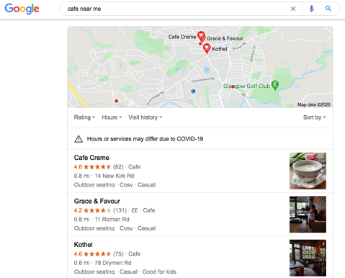
Referrals
Use word of mouth to reach further
Use loyalty and advocacy
By going above and beyond when delivering your services
Ask for reviews, feedback, testimonials and recommendations

Slide 15
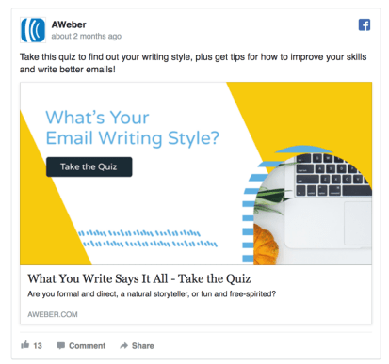
Paid campaigns
Social and Pay per click
Further expand your reach with paid campaigns, once all your digital assets are in place
Pay per click campaign performance depends on the overall ranking of your website
Use the best targeting tools available on social – don’t just boost posts.

Slide 16
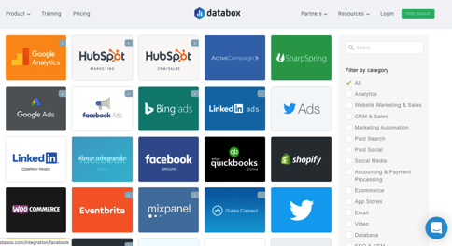
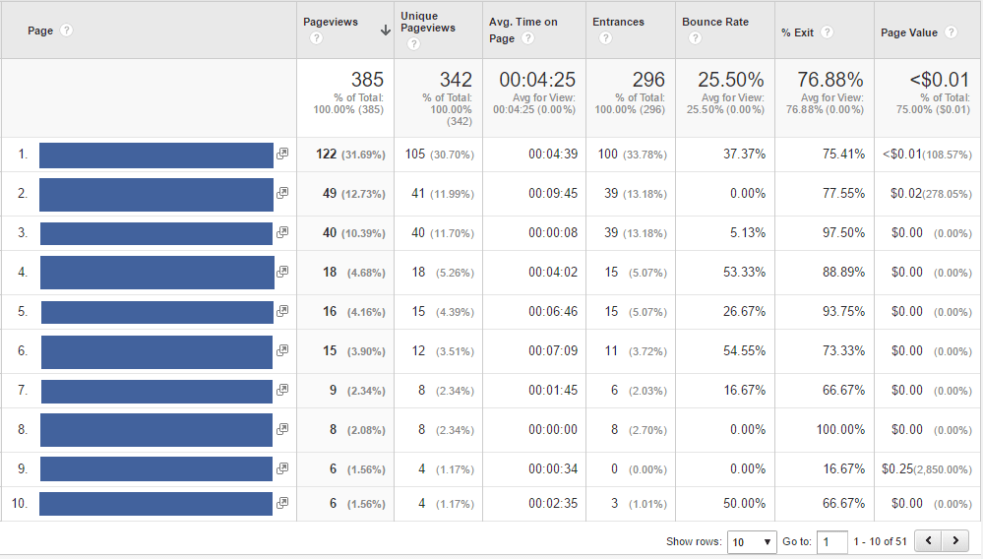
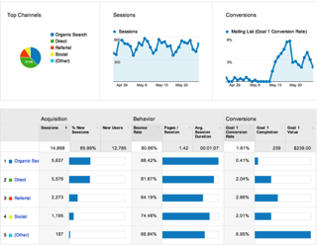
Monitor your progress
Monthly analyze your traffic volume
Use a free dashboard like Databox
Or Google Analytics:
To see most read pages on your website open Google Analytics and navigate to Behavior -> Site Content -> All Pages.
To see website traffic sources, open Google Analytics and navigate to Acquisition ->All Traffic
Notes:
Practical exercise – 10 mins

Slide 18
Thank you!
ina@biscottidigital.co.uk

