Slide 1
Welcome to Finding New Customers

Slide 2
Objectives for today
To help you to understand your own business Sales Funnel
Make more introductions, to lead to new Prospects
Show you a system to generate targeted leads
Help you to engage with your audience
To help you build a meaningful audience

Slide 3
Why do we need to prospect for new clients?

Slide 4
Even the best business looks like this sometimes

Slide 5
The Prospecting Sales Funnel

Slide 6
Do you have a stack of these in your office?

Slide 7
Building your Prospecting Sales Funnel
Sales leads
Suspects
Prospects
Prioritised Prospects

Slide 8
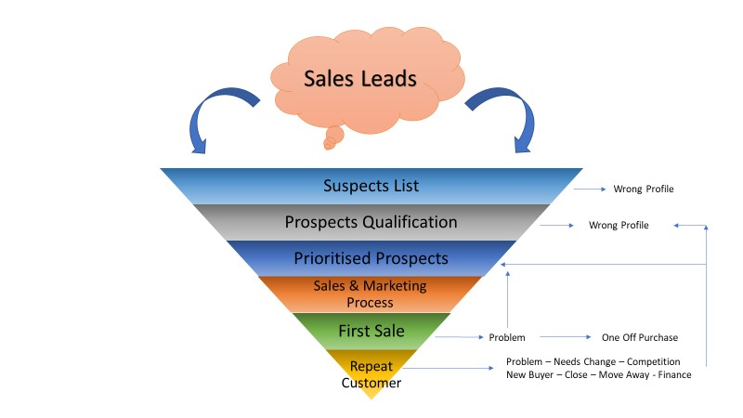

Slide 9
Prioritising your Prospects
Prospects
Prospects
C’s
B’s
A’s

Slide 10
Identifying Sales Leads
Where can you find your sales leads?

Slide 11
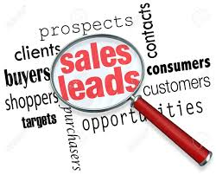
Identifying Sales Leads
It’s probably never been easier to identify sales leads.
Getting leads is the easy part – doing something with them to turn a lead into a prospect takes effort and process

Slide 12
Sales Leads from Social Media
You can create a straightforward system to generate leads from various Social Media platforms
Once created, these systems will work 24/7 to generate leads and feed you contact details
Requires time, effort & some technical knowledge to initially set up, but once done, require minimal input

Slide 14
Identifying your Sales Leads
Networking – a great way to meet new suspects

Slide 15
Networking
When did you last attend a local networking meeting?
Great way to meet lots of new suspects and to build face to face relationships
Meet – Know – Like – Trust
Getting to know your Prospects and building trust is critical

Slide 16
Identifying your Sales Leads
LinkedIn – a great way to engage & research new suspects

Slide 17
LinkedIn for Prospecting
LinkedIn has
575 million users worldwide
260 million active users worldwide
20 million
users in UK
58% of the UK working population can be found on LinkedIn

Slide 18
Using LinkedIn to engage
We’ve seen that LinkedIn can be a useful medium to build an audience and engage with potential clients,
It’s key to be connecting with relevant people and to engage with them; remember the Meet – Know – Like – Trust model,
We’re going to look at 3 straightforward ways to build your audience with relevant people and to engage with them,
We’ll also look at how not to do it.

Slide 19
Who’s viewed My Profile

Slide 20
Who’s reacted to My Activity

Slide 21
Using targeted search – by location

Slide 22
Using targeted search – by profession

Slide 23
Making new connections

Slide 24
Once you’ve connected, you need to engage

Slide 25
How NOT to do it

Slide 26
Let’s Review
We’ve looked at why prospecting is important for every business,
We’ve looked at 3 different ways for you to generate sales leads,
We’ve introduced you to the Prospecting Funnel,
We’ve focused upon how to use LinkedIn effectively to build relevant connections.

