Slide 1
GENERAL DEMOGRAPHICS
60% FEMALE 40 % MALE
60% 16-24 YEARS OLD
26% 25-44 YEARS OLD
THE AUDIENCE IS GETTING OLDER ALL THE TIME

Slide 2
OPTIMISE YOUR PROFILE-1
WHO ARE YOU? IN THREE SECONDS!
FOLLOW YOU
WATCH YOUR CONTENT
JUMP TO YOUR OTHER SOCIALS

Slide 3
OPTIMISE YOUR PROFILE-2
CONCISE BIO
LINK TO INSTA/YOUTUBE
PROFILE LINK
GOOD PROFILE PIC
PRIVATE YOUR FAVOURITES

Slide 4
GETTING FAMILIAR WITH THE APP
MUSIC-CLICK SOUNDS-ADD TO FAVOURITES
VIDEOS-LIKE YOUR FAVOURITES
HASHTAGS-FOLLOW WHAT YOU WANT
DUET-SIDE BY SIDE VIDEO WITH A POPULAR POST
REACT-OTHER VIDEO IS SMALL IN THE CORNER
FOLLOW PEOPLE-TO STAY UP TO DATE WITH CONTENT YOU LIKE

Slide 5
UNDERSTANDING ANALYTICS
GO TO MANAGE MY ACCOUNT AND
CHANGE TO “PRO ACCOUNT”
WHAT IS PERFORMING WELL?
UNDERSTAND TRAFFIC SOURCES
FOLLOWING OR FOR YOU?
“ENGAGEMENT RATE” IS
THE MOST IMPORTANT

Slide 6
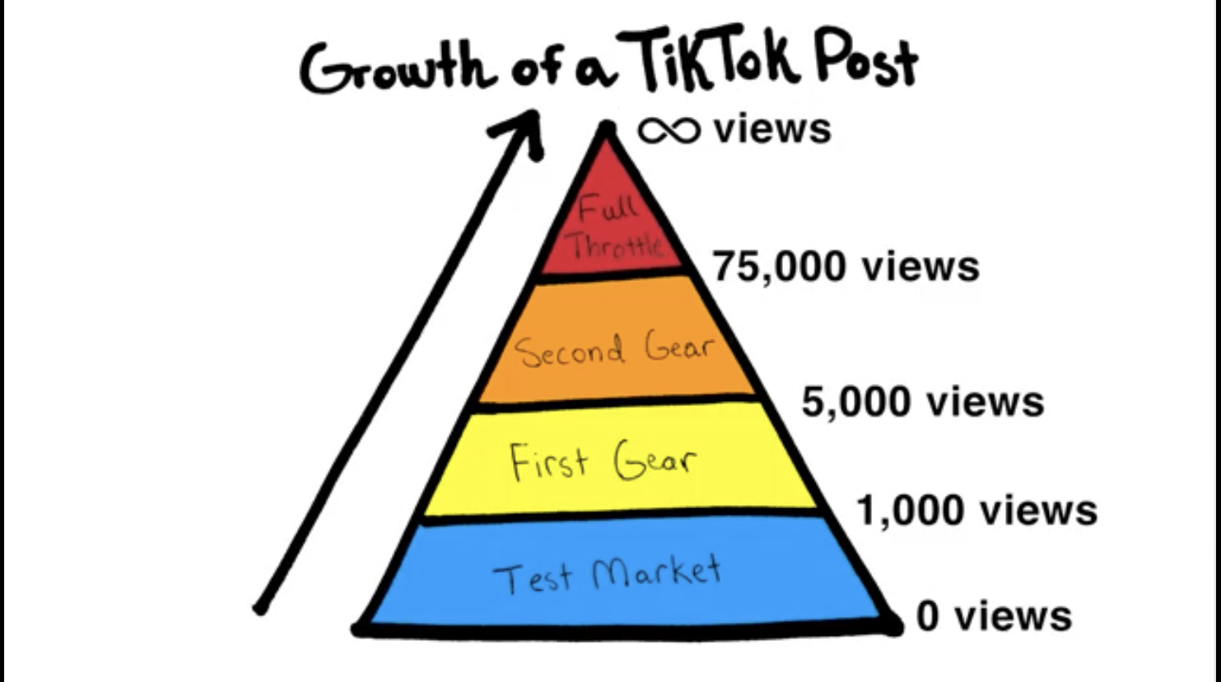

Slide 7
CRAFTING A VIRAL POST
CAPTURE ATTENTION QUICKLY
TELL A STORY-NARRATE?
MAKE IT VERTICAL
KEEP IT SHORT AND SWEET
PERSONALITY SELLS-SHOW YOUR FACE
BE AUTHENTIC
HOP ON TRENDS
DON’T TRY TOO HARD!

Slide 8
LAUNCH OPTIMISATION
USE POPULAR SONGS
KEEP DESCRIPTIONS SHORT-150 CHARACTERS
HASHTAGS-GOOD FOR NICHE CONTENT/VARY THEM /LOCATIONS
THUMBNAILS
FOLLOW-UP ENGAGEMENT
VIRAL POST FOLLOW UP
POST TIMING-ONE A DAY

Slide 9
BRAND BUILDING
(OFF TIK TOK)
NO ONE CARES/FICKLE/SHALLOW
NOT COMMUNITY-BASED
END OF VIDEO LINKS
GETTING TOP COMMENT-ENGAGE AND ADD LINK
PROFILE LINK
CROSS=PLATFORM LINKS-”DM ME ON INSTAGRAM”

Slide 10
BRAND BUILDING 2
(GROWING ON TIK TOK)
DIRECT COLLABORATIONS TO SYPHEN FANS-START SMALL AND LOCAL
SURPRISE COLLABORATIONS-DO GREAT CONTENT HOPING THE ORIGINAL POSTER WILL REPOST (TAG THEM IN CAPTION/COMMENTS/ENCOURAGE OTHERS TO COMMENT)
DM THEM- ASK FOR COLLABS

Slide 11
TYPES OF VIRALITY
ACCIDENTALS- RANDOM
ONE-HIT WONDERS- NOT A LOT OF FOLLOWERS WILL BE GAINED
BRAND BUILDERS- READY AND PREPARED FOR VIRALITY/CONSISTENCY

Slide 12
TOP TIP
TIK TOK PRIORITISES FIRST WEEK USERS TO KEEP YOU ON THE PLATFORM.
VIRALITY IS MORE COMMON EARLY ON AND SHOULD BE DISCOUNTED UNLESS CAPITALISED ON.
VIRALITY LATER IS MORE IMPORTANT.

Slide 13
IDEAS FOR BUSINESSES
BEHIND THE SCENES CONTENT
TUTORIALS
HUMOUR
POPULAR TRENDS
INFLUENCERS

Slide 14
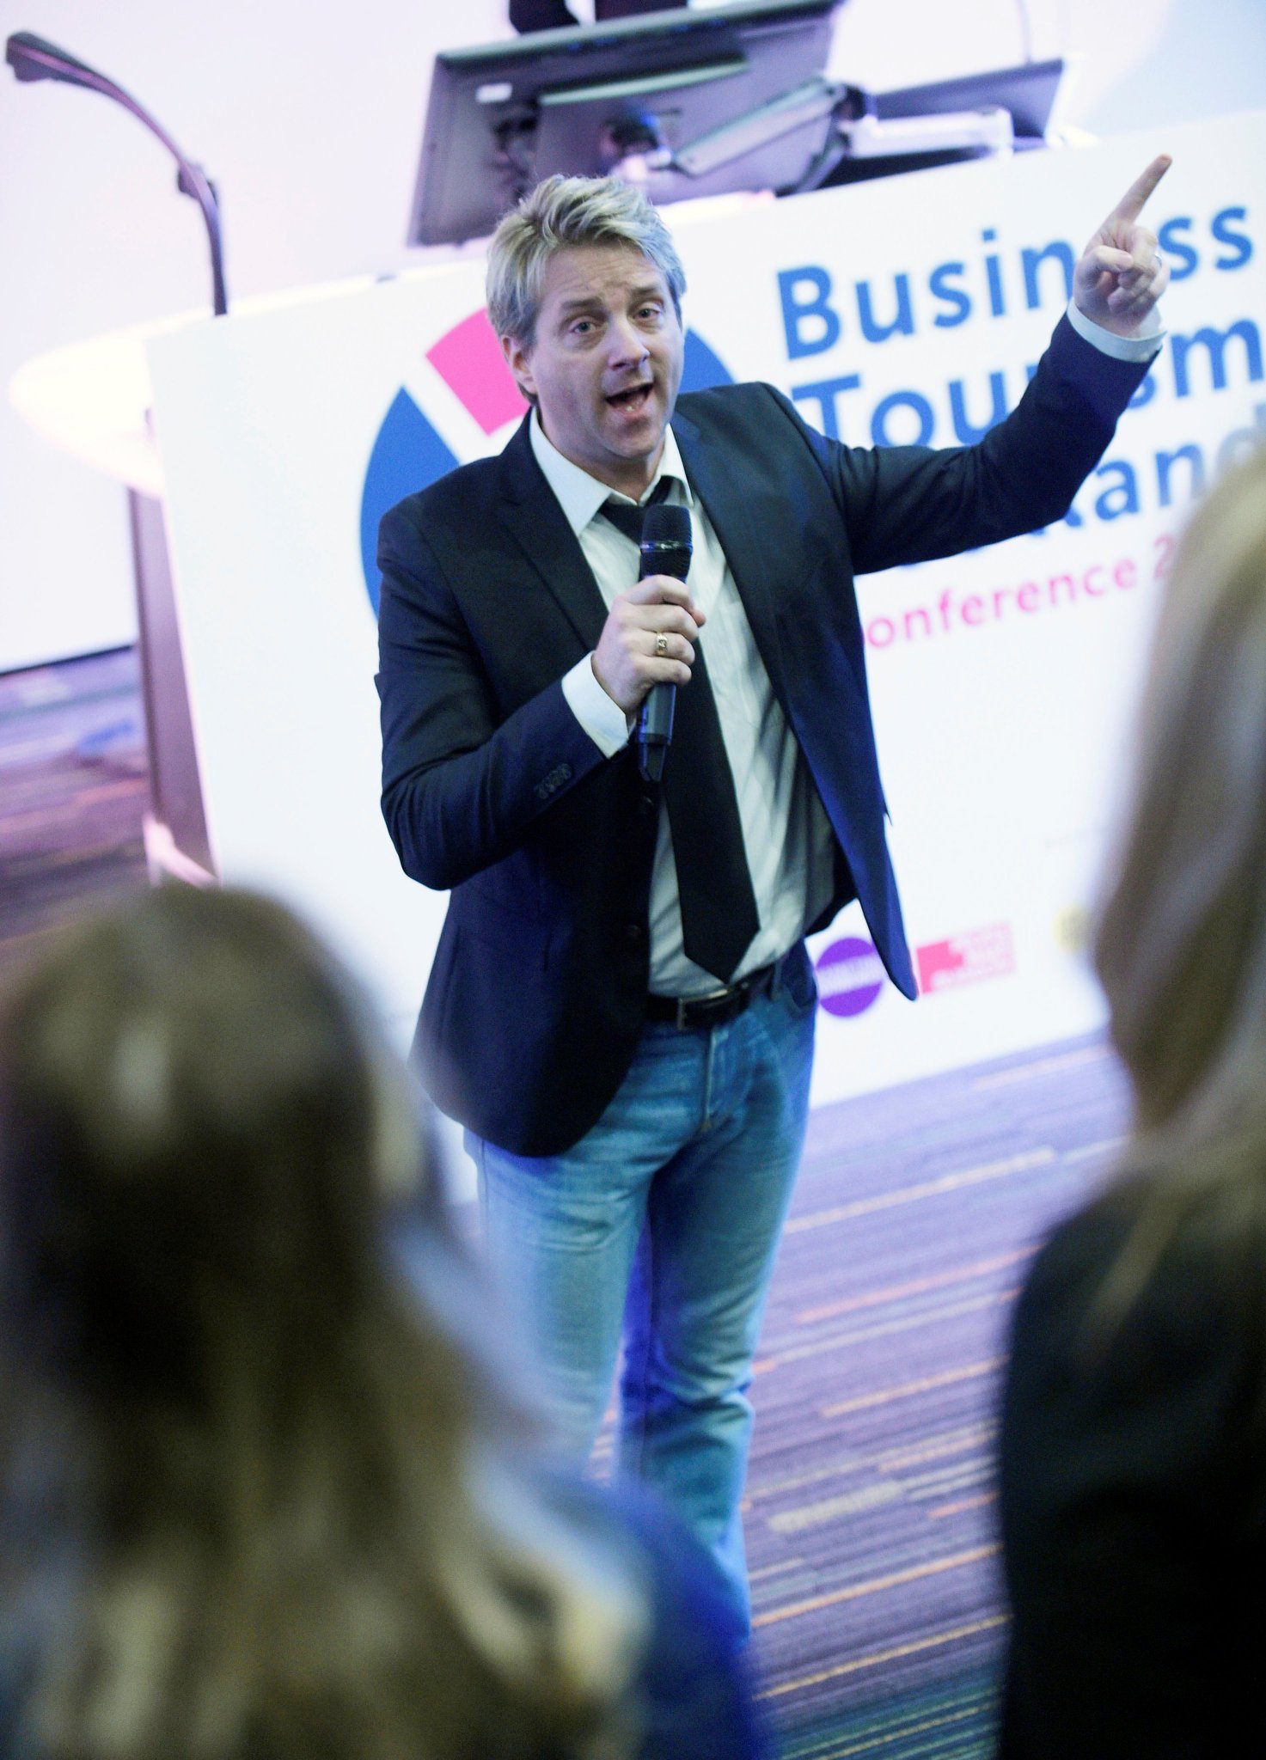
Q & A

Slide 15
Business Gateway East Dunbartonshire
Offices in Kirkintilloch and Milngavie
Here to support both people planning on setting up their own business and existing companies within East Dunbartonshire
We provide practical assistance, training workshops, networking opportunities and information on the support available throughout the enterprise network and beyond
Call 0141 578 8530 to arrange to meet a Business Adviser

