Slide 1
DIGITAL ANALYTICS
FOR BEGINNERS
With Compass Marketing
03/07/2020

Slide 2
INTRODUCTION
Welcome to today’s Digital Analytics for Beginners.
Today we are going to cover:
Web analytics
Social analytics

Slide 3
Precipitated by the global Coronavirus Pandemic, Redpath Bruce are excited to have embraced flexible home working which will immediately reduce our corporate carbon footprint, improve the health and well-being of our staff and through their increased productivity ultimately benefit our clients and the overall Redpath Bruce customer journey. #workingfromhome #flexibleworking #propertymanagers #propertymanagement
OVERVIEW
Measuring how well digital marketing is working is one of the greatest problems that small businesses face.
There are so many tools now available to help monitor, measure and interpret. Where to begin>
The simplest split or breakdown is:
Web analytics
Social analytics
Paid analytics – covered in our advance analytics – CPC etc
- what does it solve for them?

Slide 4
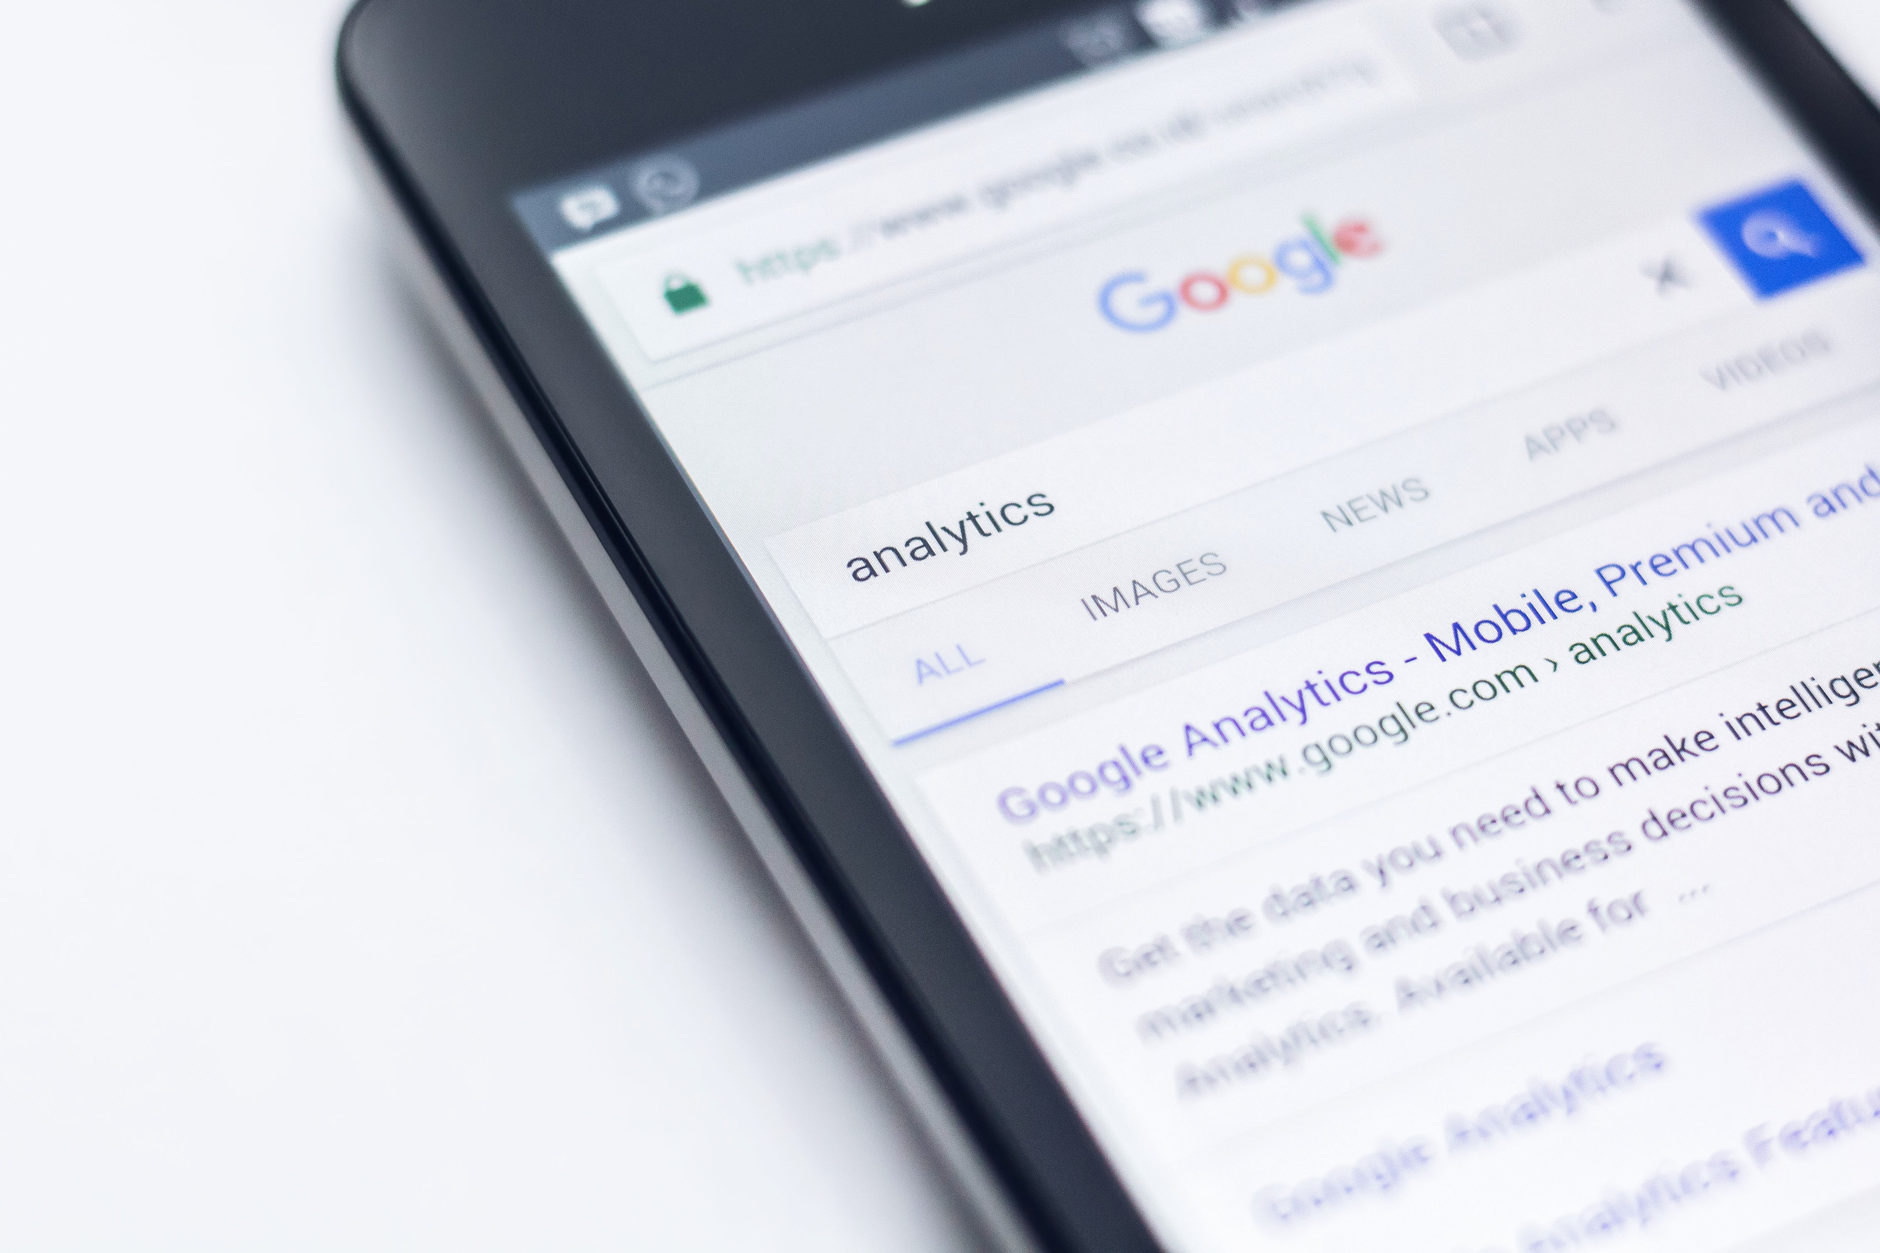
WEB ANALYTICS
What is it? The measurement, analysis and reporting of activity taking place on and relating to your website.
Why should I do it? In a nutshell – to make smarter, more informed decisions. TO see what’s working and what is not.
What tool should I use? OK, there are a few tools out there, more as of recently, but I cannot see past Google Analytics. It’s 100% free and exhaustive.

Slide 5
SETTING UP GOOGLE ANALYTICS.
- Some of you will have google analytics, but if you don’t here is how to set is up.
- Visit analytics.google.com
- If you have a Google account, sign in. If you do not have a Google account, click create an account.
- Once you have signed in or created an account, click access Google Analytics.
- Select Sign up.
- Fill in your Account Name, Website Name, Website URL, and select an Industry Category and Reporting Time Zone.
- Under Data Sharing Options, check the boxes next to the options that you want.
Click Get Tracking ID.
- From the Google Analytics Terms of Service Agreement that opens, click I Accept.
- If you don’t know if your site has GA – use this handy tool http://www.gachecker.com/

Slide 6
SETTING UP GOOGLE ANALYTICS (cont.)
To add Google Analytics to your website, consult your webmaster if you have one OR most platforms make it
super easy to add. Below are steps for Wix and Squarespace. If you are on a different platform and need help, just
get in touch and I will be able to help you.
Add the Tracking ID to Your Wix Site
Go to Marketing Integrations.
Go to Google Analytics and click Connect.
At the top right click Connect Google Analytics.
Paste your Google Analytics ID. Note: Make sure that there are no extra spaces before the code.
Select the IP Anonymization checkbox to ensure that Google does not save your site visitors' IP addresses.
Click Save.
Add the Tracking ID to Your Squarespace Site
In the Home Menu, click Settings, and then click Advanced.
Click External API Keys.
In the Google Analytics Account Number field, enter your tracking ID for this site. For help finding this ID, visit Google's documentation.
Click Save.

Slide 7
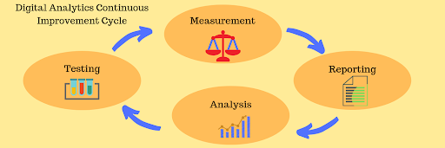
GOOGLE ANALYTICS - How it works
The software tool improves your chances of success by collecting data about your customers from all of your online platforms: websites, mobile applications, and social media.
This information makes it plain to see where things are going right, going poorly, and, where adjustments are needed.

Slide 8
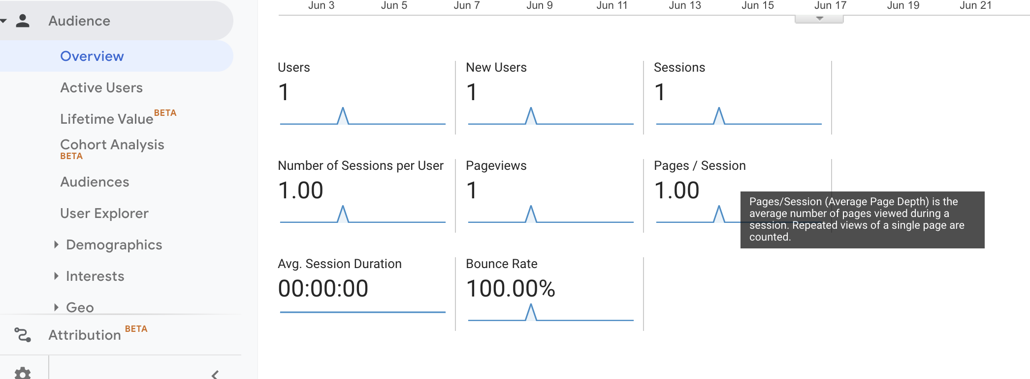
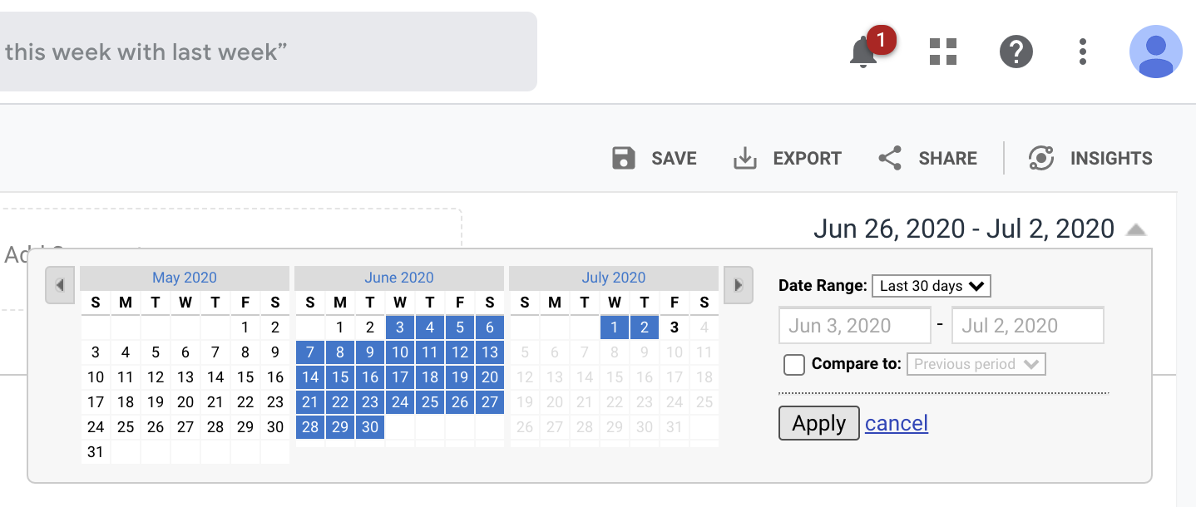
GOOGLE ANALYTICS
What reports should I check? Where do I begin?! WARNING!!!
MAIN REPORTS IN GA
Audience>overview: users, new or return users, sessions, page views
Acquisition
Geo>location
Mobile>Overview
Demographics>age (& gender)
The first graphic below shows what appears if you click on the little arrow under timeline
The 2nd one shows what appears when you click on +create new annotation
Below – shows how to select timeline in GA

Slide 9
GOOGLE ANALYTICS

Slide 10
DIGITAL MARKETING ANALYTICS
What is it? The measurement, analysis and reporting of activity taking place on your social media channels
Why should I do it? SAME - In a nutshell – to make smarter, more informed decisions. TO see what’s working and what is not.
What tool should I use? For basic information and what I am covering today, Facebook and Instagram’s own analytics functions are more than enough.

Slide 11
DIGITAL MARKETING ANALYTICS
The following are digital marketing metrics associated with content and social media.
Engagement Rate total number of comments, clicks, likes (engagements) as a proportion of the total number page or post views
Follows and Subscribes - total number who want to receive updates when new posts or pages are published
Shares - total times a post or page has been shared

Slide 12
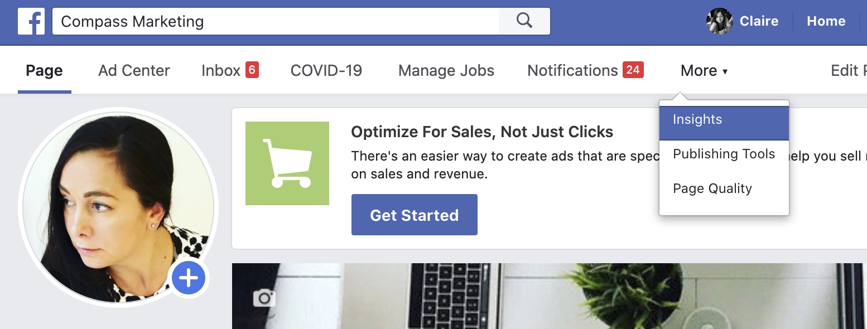
FACEBOOK
Use Facebook for your business? You MUST dig into Facebook analytics.
The section you are concerned with is “Facebook Page Insights”
detailed analytics for your Facebook Page
Check what works, how people interact with your content
Pull reports, analyse patterns and see what’s working and what’s not
How to use Facebook analytics
Go to your Facebook Page and click Insights in the top menu.
If you don’t see Insights in the menu, click More to bring it up.
You’ll be taken straight to your Overview, which you can access again at any time by clicking Overview in the left-hand menu.
The Overview gives you a bird’s-eye view of everything that’s happening with your Facebook Page. You can choose to view data for the last seven or 28 days, for the current day, or for the previous day.
The Overview is broken down section – you want to pay attention to the 1st 2: Page Summary – and Posts

Slide 13
FACEBOOK PAGE INSIGHTS: PAGE SUMMARY
Top level information and metrics for the selected timeline:
Actions on Page: total clicks for your contact information and call-to-action button
Page views: Total views of your Facebook Page
Page Previews: The number of times people hovered their mouse over your Page information to see a preview of your Page.
Page Likes: The number of new likes.
Post reach: The number of people who saw your posts in their timeline.
Story reach: The number of people who saw your Stories.
Recommendations: The number of people who recommended your Page.
Post engagement: A combined total of post likes, comments, shares, and other engagements.
Responsiveness: An evaluation of how often and how fast you respond to messages.
Videos: The number of video views of three seconds of more.
Page followers: The number of new followers
Orders: Your orders and earnings.
• They need to be consistent and flow.

Slide 14
FACEBOOK PAGE INSIGHTS: the other section!
Click on Your % Most Recent Posts and it takes you to a new page with 3 tabs at the top:
When Your Fans Are Online
Post Types
Top Posts From Pages You Watch
When your fans are online
Averaged out summary for the time period you choose.
Scroll your mouse across the graph for hourly info .
See specific patterns for the various days of the week by moving over the days boxes above the graph. Does your audience have the same browsing patterns on the weekends as they do during the week?
Post types
How well one type of post performs v another – eg video v image
Top posts from Pages you watch
Engagement info for insight about what kinds of content are working for your competitors or fellow brands

Slide 15
INSTAGRAM ANALYTICS
What are Instagram analytics?
Unsurprisingly, Instagram analytics tell you your activity within Instagram is performing!!!
Too many to list today, but here are the 8 main ones you should look at.
1. Story completion rate
How many people looked at all of the posts in your story – Instagram wont calculate this for you, so you need to use the grey cells:
You need to know what the story exit rate is: Instagram Profile > Hamburger Menu (upper right corner) > Insights > Content > Stories.
Then select the story you want to see insights on, and you can see reach, taps back, taps forward, replies, swipe away, and exits.
Reach – (Swipe Away + Exits) = Story Completion Rate
2. Hashtag usage
Again, one to track manually – simply type hashtag into the search box and you will see how many folk are using it – we could talk about hashtags alone for ages, but will do another course on it but for now, the magic formula…..
3. CTR to website
Link in your Insta bio. Track how often folk go from your account to your website.
Instagram Profile > Hamburger Menu (right corner) > Insights > Actions. Just scroll down a bit to see your website clicks. A really good indicator.

Slide 16
INSTAGRAM ANALYTICS
4. Discovery is a set of Instagram analytics metrics that track the total reach and impressions of your content.
Reach tells you the number of unique accounts that have seen your posts.
Impressions are the total number of times all your posts have been seen.
What discovery tells you:
- what days your posts are seen the most
- where they are seen the most
- Increase or decrease on the week prior.
- Were posts were seen by accounts that aren’t following you.
Profile (profile photo in the bottom right corner of your Instagram feed) > Hamburger menu in upper right corner > Insights.
Discovery will be the second section on the front tab of your Insights.
5. Instagram engagement rate per follower
Instagram rewards high engagement rates by showing more of your content- you need to track this!
Do your followers like, comment, or save your stuff?
(Likes + Comments) / Number of Followers * 100 = Engagement rate

Slide 17
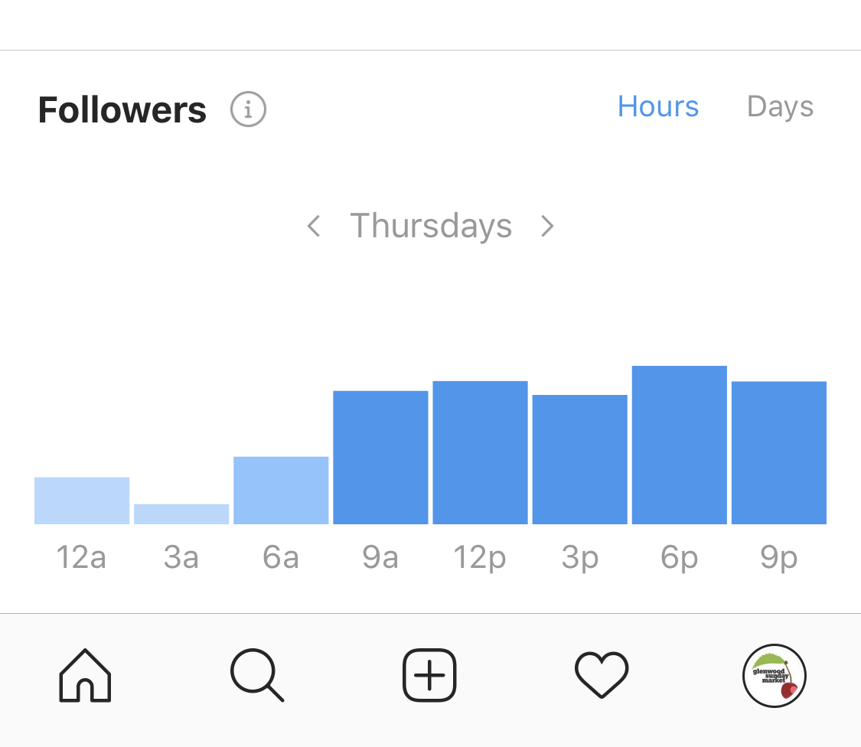
6. Engagement per post
(Likes + Comments) / Number of Posts = Engagement Per Post
Here is what it will look like in action, calculating for the past week.
(250 likes + 100 comments in the last week) = 350
350/25 ← (number of posts in the last week) = 14
Now you have a starting point to see if posts are getting more or less than average engagement. Pay attention to posts that do better than average so you can increase that type of content.
7. Time of activity
Open Instagram, then go to Profile > Hamburger Icon > Insights > Audience.
Scroll down to “Followers” and you will see what times and days your followers are online.

Slide 18
8. Top performing Instagram posts
Remember to check topics, times, or a hashtag.
Your Profile > Hamburger Menu > Insights > Content > See All (next to Feed Posts)
Instagram will automatically sort your posts in order of engagement over the past year, but you can use the filters to view based on Follows, Comments, etc. You can also change the time frame and sort by the type of content.
You MUST keep notes and evaluate. Use my reporting template to keep tabs and spot patterns

Slide 19
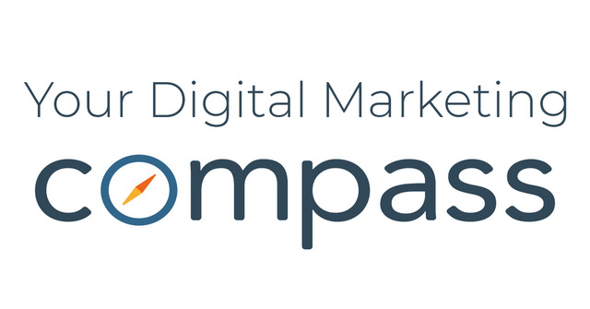
THANK YOU FOR LISTENING
QUESTIONS TO claire@gocompass.co.uk
Or join our digital support Facebook group @yourdigitalmarketingcompass
1 JULY, 2020

